Slide 1
Test automation with Jmeter
Foundations of software testing
Rafał Nikiel
20.11.2015

Slide 2
AGENDA
Introduction to performance tests
What is Jmeter ?
What we can do with Jmeter?
Excercises
Summary

Slide 3
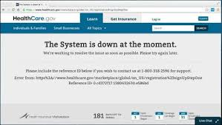

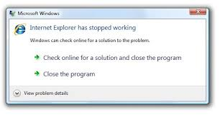

Non-functional testing
Introduction to Performance TESTS
The testing of software attributes which are not related to any specific function or user action like performance, scalability, security or behavior of application under certain constraints.
Non functional testing has a great influence on customer and user satisfaction with the product.
Why? Any examples ?
"Nobody's madder than me about the website not working as well as it should, which means it's going to get fixed,"

Slide 4
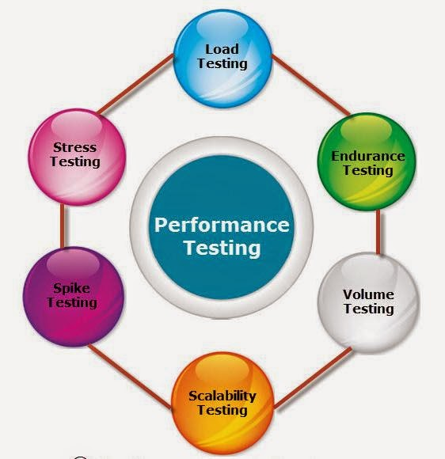
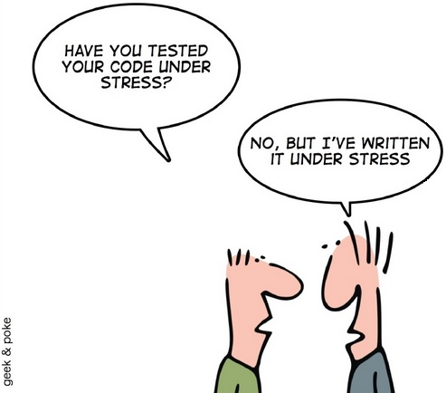
Types of performance testing
Introduction to Performance TESTS
Validate that the system performs as expected when concurrent users access the application and gets the expected response time.
A long-running test that is used to determine application performance and/or stability over time. Often used to find memory leaks.
Stress testing is the test to find the ways to break the system. The test also gives the idea for the maximum load the system can hold.
Volume test is to verify if the performance of the application is not affected by volume of data that is being handled by the application
Quite similar to load testing but focused more on checking what can be improved on hardware site to keep the good performance.
Dramatic increase of the load and then decrease. Should verify that an application recovers between periods of spike activity.

Slide 5
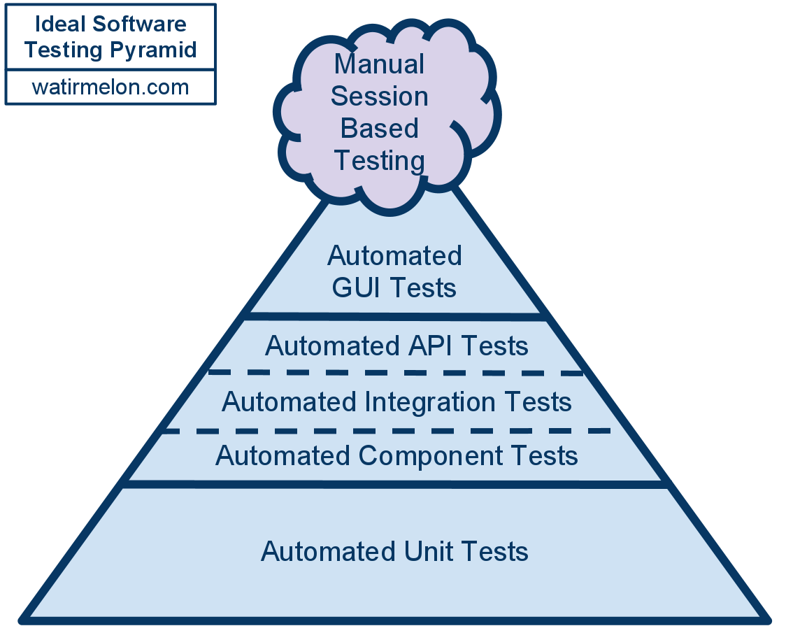
Testing pyramid - automation
Introduction to performance tests
System tests
Integration tests
Unit tests

Slide 6
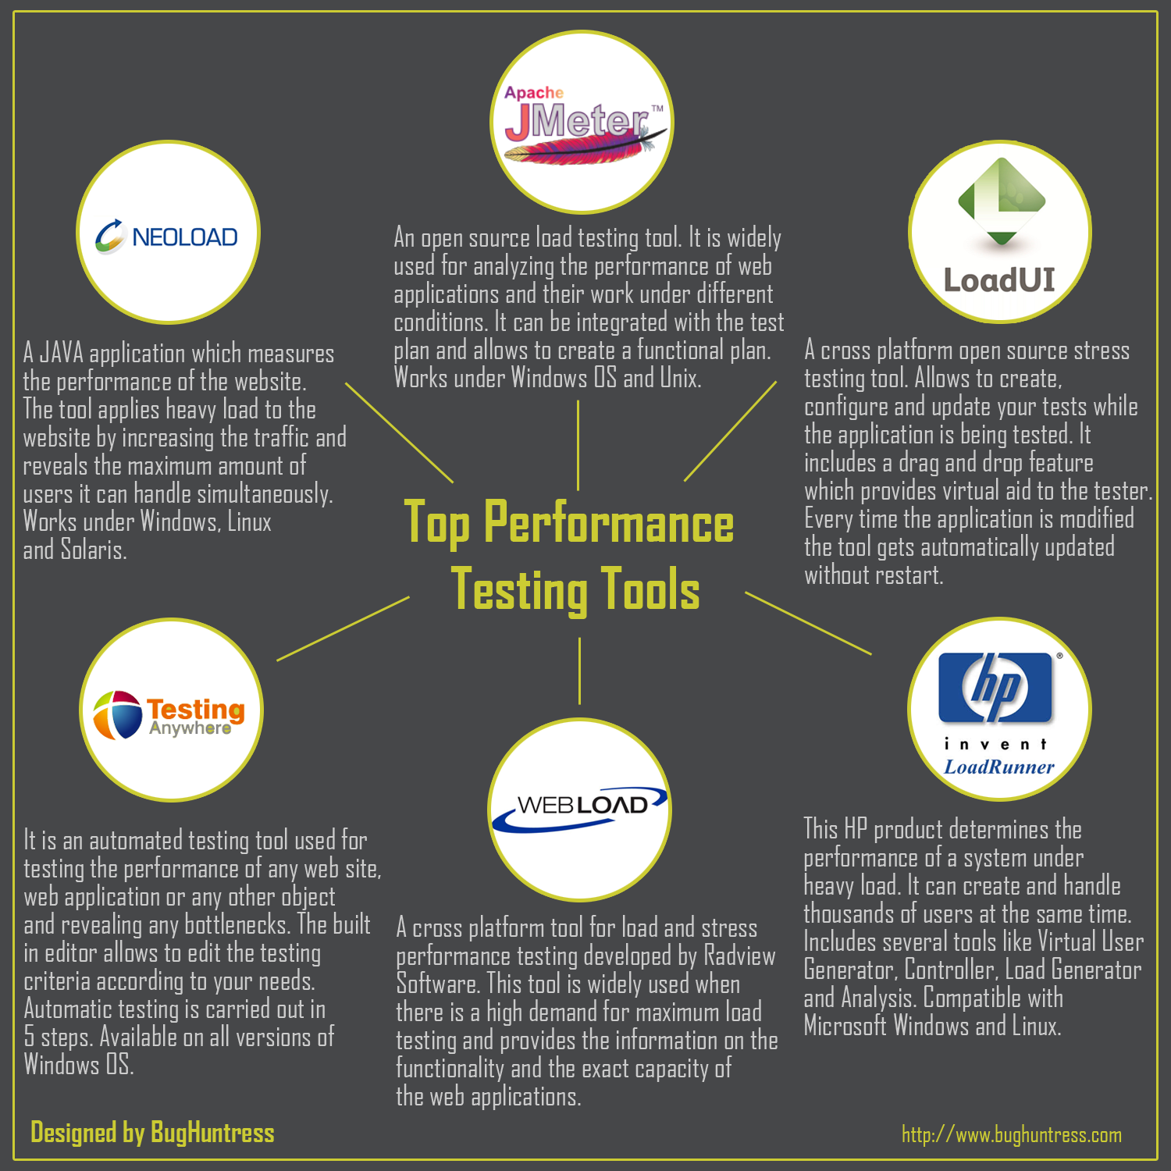
Automating performance tests
Introduction to performance tests
Measure what is measurable and what is not measurable – Make measurable” - Galileo Galilei
Why automation is the best choise for that types of tests:
Hard to perform manually
Hard to measure manually
Hard to repeat manually
Performance testing tools can :
Simulate real or stress performance scenarios
Monitor and report the metrics and fails

Slide 7


Slide 8


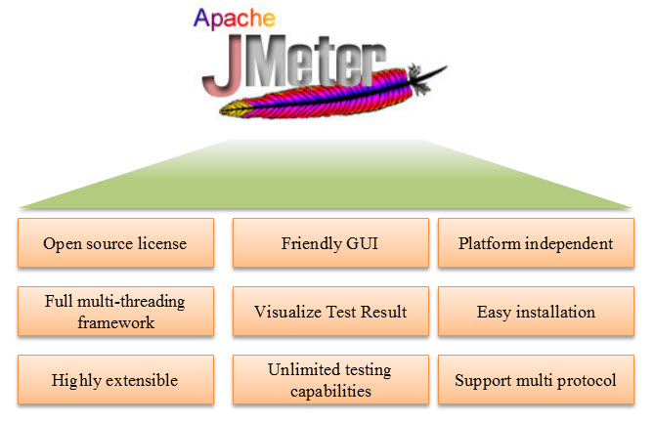


Why JMeter ?
Jmeter

Slide 9
Task 1 – getting familiar with the tool
Jmeter ExcerciseS
Ensure that you have JDK installed
Ensure that JAVA_HOME is properly set
Download Jmeter 2.13
Unzip and run executable jar file
Add Thread Group to the Test Plan
Get familiar with the structure and elements that can be added to the Thread Group
http://www.oracle.com/technetwork/java/javase/downloads/jdk8-downloads-2133151.html
echo %JAVA_HOME%
set JAVA_HOME = C:\Program Files\Java\jdk1.8.0_xx
http://jmeter.apache.org/download_jmeter.cgi
Notes:
Possible issues:
Proxy
Lack od jdk installed
Java_home not set

Slide 10
Task 1 – getting familiar with the tool
Jmeter ExcerciseS
Element | Functionality
Thread groups | All controllers and samplers must be under a thread group. Other elements, may be placed directly under the test plan, in which case they will apply to all the thread groups. This element controls the number of threads JMeter will use to execute your test.
Logical Controllers | Let you customize the logic that JMeter uses to decide when to send requests.
Samplers | Tell JMeter to send requests to a server.
Listeners | Are ways to access or show the information about run results. For example there are Result Graphs or View Results Trees.
Timers | Allows to configure a delay between requests, in order not to overwhelm the server.
Assertions | Statements of a fact that represents the rule of what must be returned by the application by a certain point.
Configuration | They work with samples and are able to add or modify requests.
Notes:
Possible issues:
Proxy
Lack od jdk installed
Java_home not set

Slide 11
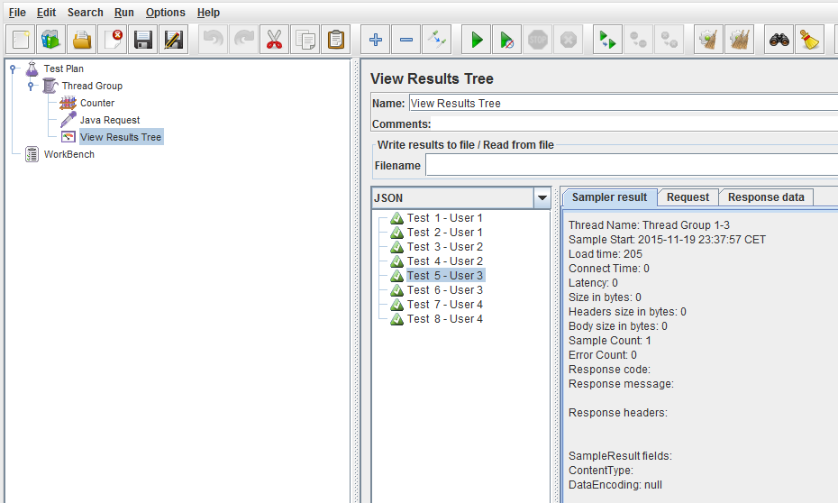
Task 2 – Create simple JavaRequest
Jmeter ExcerciseS
Add JavaRequest from Samplers and ResultsTree from Listeners (right click on Thread Group)
Change Label parameter in JavaRequest and run test plan (Ctrl+R).
Check results in Results Tree
Increase Threads Parameters and run test plan again (useful shortcuts ->Ctrl+S, Ctrl+E, Ctrl+R)
Change label to „Test User”
Generate function string for __threadNum from FunctionHelperDialog and add this string at the end of Label
Run Test Plan and check results
Add Counter element and use it also in JavaRequest Label (use following method ${xx} where xx is Counter Reference name)
Run Test Plan and check results
Notes:
Possible issues:
Proxy
Lack od jdk installed
Java_home not set

Slide 12
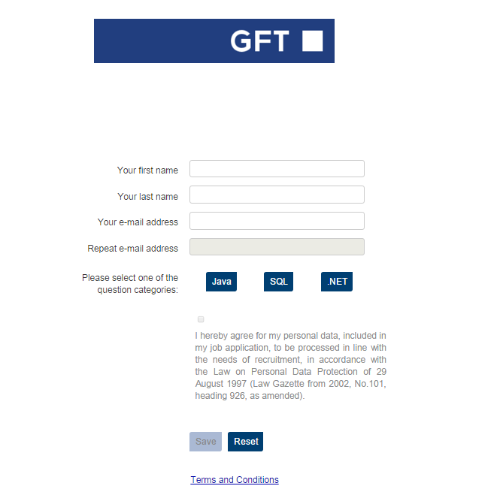
Task 3a – Prepare application
Jmeter ExcerciseS
Download RCApp zip from GITRepository
Unzip the archive and go to tomcat bin directory (.. rcapp_external_db\rcapp\apache-tomcat-6.0.44\bin)
Run command line from that path and start tomcat by executing „startup” command
Once Tomcat server will be started go following url: http://localhost:8080/registrationform/?contestId=1
Check if you see the the screen similar to presented on the left
Check basic functionality of the contest (register your answer for whichever question)
Notes:
Possible issues:
Proxy
Lack od jdk installed
Java_home not set

Slide 13
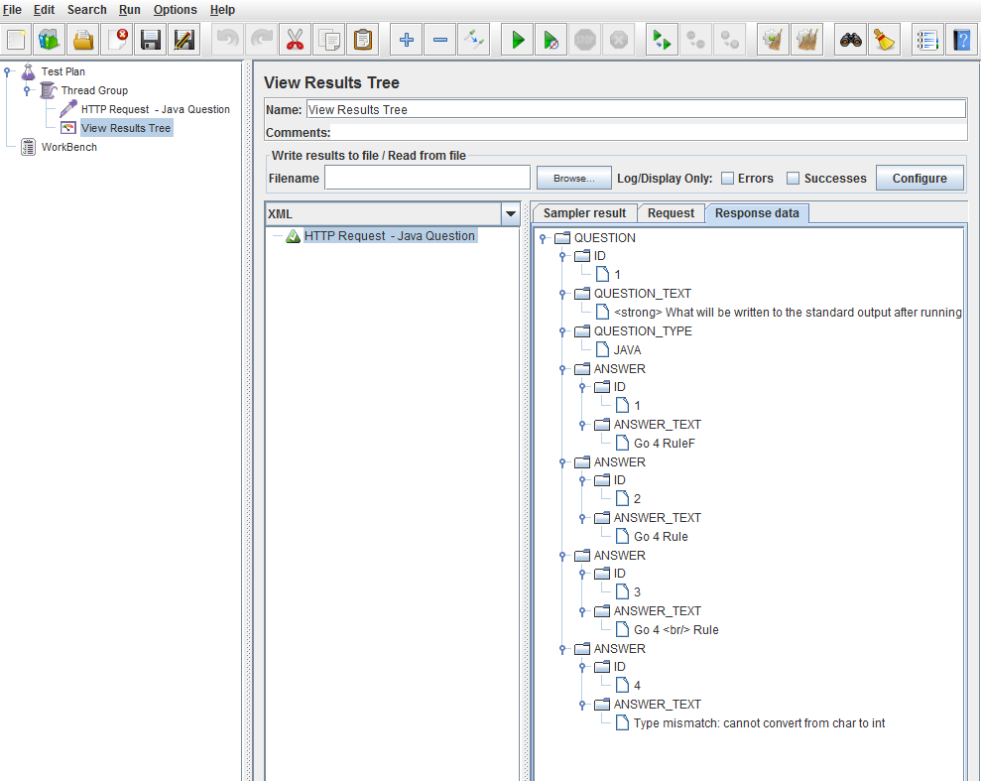
Task 3b – Using HTTP Request retrieve a JAVA question
Jmeter ExcerciseS
Create an empty Test Plan and change its name to Test Plan – Task 3b.
Save the test plan by the name of Task_3b.jmx.
Add Thread Group.
Add HTTP Request (Add > Sampler > HTTP Request) to the Thread Group and change its name to HTTP Request – JAVA question. Change the relevant settings as below:
a. Server Name or IP: 127.0.0.1
b. Port Number: 8080
c. Protocol [http]: HTTP
d. Method: GET
e. Content encoding: UTF-8
f. Path: /registrationform/registrations/JAVA
Add View Result Tree to the Test Plan to observe flow of the test.
Run test plan (please note that API will repond with randomly chosen question)
Click on View Result Tree to see Response Data (change response format to XML)
Add two more similar HTTP Requests for SQL and DOTNET (only last parameter in PATH should be different)
Notes:
Possible issues:
Proxy
Lack od jdk installed
Java_home not set

Slide 14
Task 3c – Using HTTP Request [POST] register new user
Jmeter ExcerciseS
Create an empty Test Plan and change its name to Test Plan – Task 3c
Save the test plan by the name of Task_3c.jmx.
Add Thread Group.
Add HTTP Request and change its name to HTTP Request – register user. Change the relevant settings as below:
a. Server Name or IP: 127.0.0.1
b. Port Number: 8080
c. Protocol [http]: HTTP
d. Method: POST
e. Content encoding: UTF-8
f. Path: /registrationform/registrations/
Switch onto Body Data tab and put there xml content
Run test plan – response code 415
Add HTTP Header Manager and parameter Content-Type: text\xml
Run Test plan and check if user was registered
Run test plan again – what happened ?
Add Assertion for the Response code
<?xml version="1.0" encoding="UTF-8"?>
<REGISTRATION>
<FIRST_NAME>name</FIRST_NAME>
<LAST_NAME>name2</LAST_NAME>
<EMAIL>mailj@gft.com</EMAIL>
<QUESTION>Which one of the following keywords allows to sort the query
result?
GROUP BY
ORDER FROM
ASC BY
ORDER BY</QUESTION>
<CHALLENGE>null</CHALLENGE>
<ANSWER>null</ANSWER>
<QUESTION_ID>7</QUESTION_ID>
<ANSWER_INDEX>28</ANSWER_INDEX>
</REGISTRATION>
http://localhost:8080/registrationpanel/#RegistrationsPlace:Registrations
Login: admin
Passw:
Notes:
Possible issues:
Proxy
Lack od jdk installed
Java_home not set

Slide 15
Other JMeter posibilities
Jmeter
DB connections and testing
Using external files to upload the data
Veryfing HTM and web services responses
Parsing documents
Distributed performance tests
Recording tests
And many many more...
Notes:
Possible issues:
Proxy
Lack od jdk installed
Java_home not set

Slide 16
Links and materials
Jmeter
http://osworld.pl/testy-wydajnosciowe-za-pomoca-apache-jmeter/
https://www.digitalocean.com/community/tutorials/how-to-use-jmeter-to-record-test-scenarios
https://www.urbaninsight.com/2011/07/18/simple-load-test-with-jmeter
https://lincolnloop.com/blog/load-testing-jmeter-part-1-getting-started/
http://blog.sourcepole.com/2011/01/04/jmeter-series/
Notes:
Possible issues:
Proxy
Lack od jdk installed
Java_home not set

Slide 17
Rafał Nikiel
GFT
Rafal.Nikiel@gft.com

